Slide 1
Happy healthy highlanders
Grow and develop healthy minds together!

Slide 2
Introduction
Thank you for inviting us today, we are honoured – Val, DHT, and Wanda, Youth Development Officer.
Thrive on strong partnership working.
Exciting time having full-time Youth Worker based in Fortrose Academy (since October 2020).
This workshop will highlight the work of ‘The Famous Five’ – how they looked after their mental health and were mindful of the mental health of others.
Please now meet our young people.

Slide 3
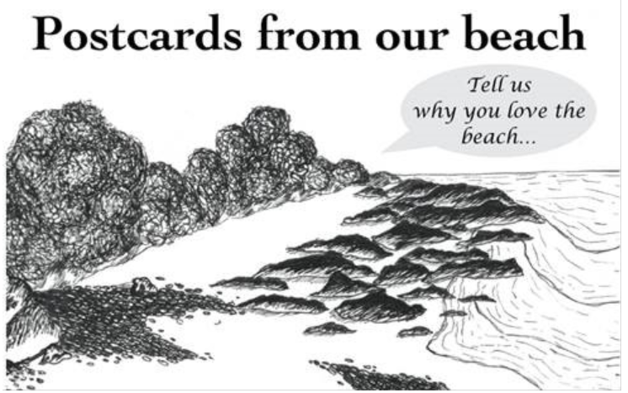
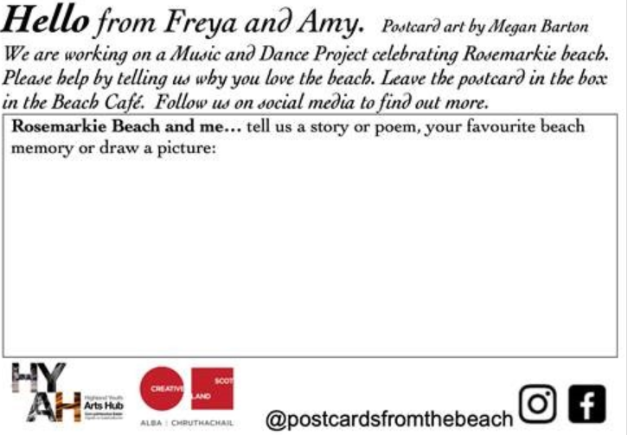
FREYA AND AMY
Freya rep on Highland Youth Parliament and National Youth Arts Advisory Group.
Amy is a Highland dancer and fiddler.
Combatting isolation and celebrating our culture and the beach.
Luck versus isolation in the arts.
Community engagement.

Slide 4
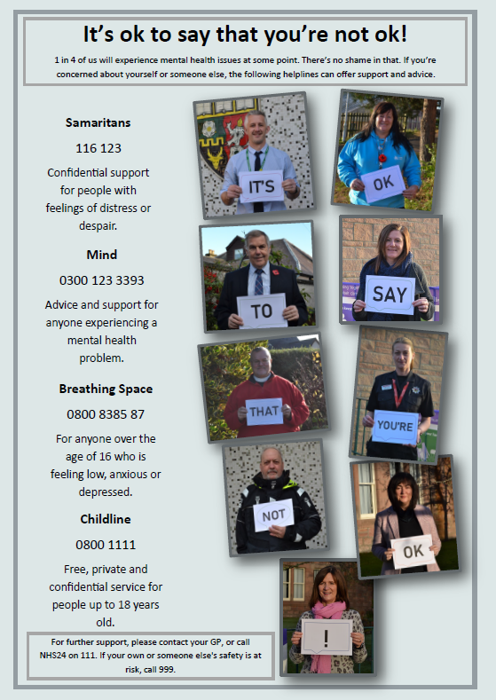
Tilly
Youth Counsellor on Cromarty Community Council.
One of Fortrose Academy’s representatives on Highland Youth Parliament.
Developing confidence and young people’s voices.
Planning and preparing poster.
Wellbeing on the Black Isle Group.
Local well-known people from various professions.
Raising awareness of mental health.
Support available locally and online.

Slide 5
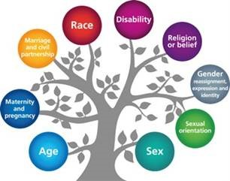
PSE Review – Anna and megan
Mental Health – post-Covid recovery
Equalities
Protected characteristics
Body Confidence
Healthy body and healthy mind
Lifeskills/PSE
Outside speakers
experts
Post school ready
CVs earlier
Gap years

Slide 6
Impact and next steps
We listened to the mental health challenges of our young people.
They directed our course of action.
Between October and April young people have participated in 25 courses resulting in 189 certificates being awarded.
Saltire volunteering/leading continues to be huge – this provides fantastic pathways which improves confidence and skills in our young people.
Digital citizens have flourished – 125 young people in Youth Work Classroom who have inspired and motivated others.
NOW our future focus is on developing mental health and resilience training in school (school support and youth work staff have completed training) so that mental health ambassadors will deliver both within school and our Black Isle community – this will enhance our already existing ‘Wellbeing on the Black Isle’ partnership work.

Slide 7
Thank you for giving us the opportunity to share the work our young people are doing on the Black Isle. It is very much appreciated.

